Slide 1

Hi-Landers Ham Class
Instructed by Rich Bugarin W6EC

Slide 2
Sub-element 5 of 10

Slide 3
Ham Radio Technician Class Exam preparation Power Point created by Rich Bugarin W6EC.
Effective July 1, 2022 and is valid until June 30, 2026.
Please send suggested changes to this presentation to:
w6ec@thebugarins.com

Slide 4
Study Hints
I suggest you read each question and only the correct answer. Read through the complete question pool at least three times before you attempt taking a practice exams. For higher impact and better results read the correct answer first then the question and again the correct answer.
The key to passing the exam is to get the most questions correct using the above method the correct response will often jump out at you on test day even if you don’t remember the question.

Slide 5
Text Color
Black: Original/Official questions and information in original format (unaltered).
Red: Original information text color simply changed to highlight subject.
Blue: Notes and information added by Rich (W6EC).

Slide 6
SUBELEMENT T6 – ELECTRONIC AND ELECTRICAL COMPONENTS
[4 Exam Questions - 4 Groups]

Slide 7
T6A - Fixed and variable resistors; Capacitors; Inductors; Fuses; Switches; Batteries
#19 of 35

Slide 8
T6A01
What electrical component opposes the flow of current in a DC circuit?
A. Inductor
B. Resistor
C. Inverter
D. Transformer

Slide 9
T6A01
What electrical component opposes the flow of current in a DC circuit?
A. Inductor
B. Resistor
C. Inverter
D. Transformer

Slide 10
T6A02
What type of component is often used as an adjustable volume control?
A. Fixed resistor
B. Power resistor
C. Potentiometer
D. Transformer

Slide 11
T6A02
What type of component is often used as an adjustable volume control?
A. Fixed resistor
B. Power resistor
C. Potentiometer
D. Transformer

Slide 12
T6A03
What electrical parameter is controlled by a potentiometer?
A. Inductance
B. Resistance
C. Capacitance
D. Field strength

Slide 13
T6A03
What electrical parameter is controlled by a potentiometer?
A. Inductance
B. Resistance
C. Capacitance
D. Field strength

Slide 14
T6A04
What electrical component stores energy in an electric field?
A. Varistor
B. Capacitor
C. Inductor
D. Diode

Slide 15
T6A04
What electrical component stores energy in an electric field?
A. Varistor
B. Capacitor
C. Inductor
D. Diode

Slide 16
T6A05
What type of electrical component consists of conductive surfaces separated by an insulator?
A. Resistor
B. Potentiometer
C. Oscillator
D. Capacitor

Slide 17
T6A05
What type of electrical component consists of conductive surfaces separated by an insulator?
A. Resistor
B. Potentiometer
C. Oscillator
D. Capacitor

Slide 18
T6A06
What type of electrical component stores energy in a magnetic field?
A. Varistor
B. Capacitor
C. Inductor
D. Diode

Slide 19
T6A06
What type of electrical component stores energy in a magnetic field?
A. Varistor
B. Capacitor
C. Inductor
D. Diode

Slide 20
T6A07
What electrical component is typically constructed as a coil of wire?
A. Switch
B. Capacitor
C. Diode
D. Inductor

Slide 21
T6A07
What electrical component is typically constructed as a coil of wire?
A. Switch
B. Capacitor
C. Diode
D. Inductor

Slide 22
T6A08
What is the function of an SPDT switch?
A. A single circuit is opened or closed
B. Two circuits are opened or closed
C. A single circuit is switched between one of two other circuits
D. Two circuits are each switched between one of two other circuits

Slide 23
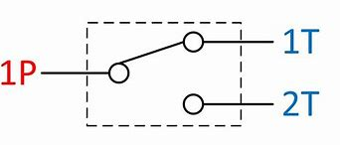
T6A08
What is the function of an SPDT switch?
A. A single circuit is opened or closed
B. Two circuits are opened or closed
C. A single circuit is switched between one of two other circuits
D. Two circuits are each switched between one of two other circuits

Slide 24
T6A09
What electrical component is used to protect other circuit components from current overloads?
A. Fuse
B. Thyratron
C. Varactor
D. All these choices are correct

Slide 25
T6A09
What electrical component is used to protect other circuit components from current overloads?
A. Fuse
B. Thyratron
C. Varactor
D. All these choices are correct

Slide 26
T6A10
Which of the following battery chemistries is rechargeable?
A. Nickel-metal hydride
B. Lithium-ion
C. Lead-acid
D. All these choices are correct

Slide 27
T6A10
Which of the following battery chemistries is rechargeable?
A. Nickel-metal hydride
B. Lithium-ion
C. Lead-acid
D. All these choices are correct

Slide 28
T6A11
Which of the following battery chemistries is not rechargeable?
A. Nickel-cadmium
B. Carbon-zinc
C. Lead-acid
D. Lithium-ion

Slide 29
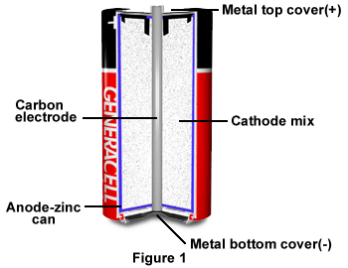
T6A11
Which of the following battery chemistries is not rechargeable?
A. Nickel-cadmium
B. Carbon-zinc
C. Lead-acid
D. Lithium-ion

Slide 30
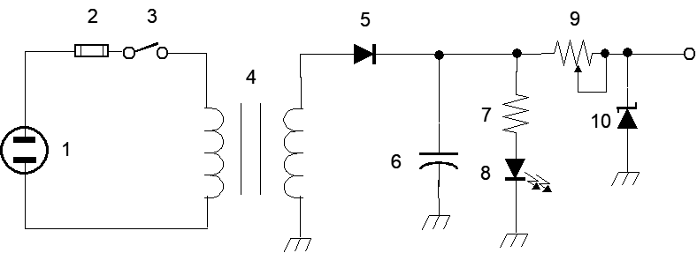
T6A12
What type of switch is represented by component 3 in figure T-2?
A. Single-pole single-throw
B. Single-pole double-throw
C. Double-pole single-throw
D. Double-pole double-throw

Slide 31
T6A12
What type of switch is represented by component 3 in figure T-2?
A. Single-pole single-throw (switch)
B. Single-pole double-throw
C. Double-pole single-throw
D. Double-pole double-throw

Slide 32
T6B – Semiconductors: basic principles and applications of solid state devices, diodes and transistors
#20 of 35

Slide 33
T6B01
Which is true about forward voltage drop in a diode?
A. It is lower in some diode types than in others
B. It is proportional to peak inverse voltage
C. It indicates that the diode is defective
D. It has no impact on the voltage delivered to the load

Slide 34
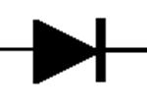
T6B01
Which is true about forward voltage drop in a diode?
A. It is lower in some diode types than in others
B. It is proportional to peak inverse voltage
C. It indicates that the diode is defective
D. It has no impact on the voltage delivered to the load
Forward Voltage for a Silicon Diode is about 0.7V for Germanium it is about 0.3V

Slide 35
T6B02
What electronic component allows current to flow in only one direction?
A. Resistor
B. Fuse
C. Diode
D. Driven element

Slide 36

T6B02
What electronic component allows current to flow in only one direction?
A. Resistor
B. Fuse
C. Diode
D. Driven element
A Diode (AKA Rectifier) functions as an
Electronic Check Valve.

Slide 37
T6B03
Which of these components can be used as an electronic switch?
A. Varistor
B. Potentiometer
C. Transistor
D. Thermistor

Slide 38
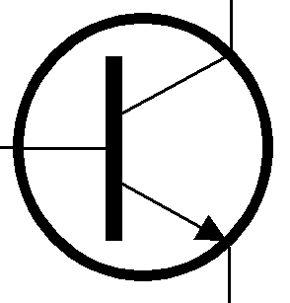
T6B03
Which of these components can be used as an electronic switch?
A. Varistor
B. Potentiometer
C. Transistor
D. Thermistor

Slide 39
T6B04
Which of the following components can consist of three regions of semiconductor material?
A. Alternator
B. Transistor
C. Triode
D. Pentagrid converter

Slide 40
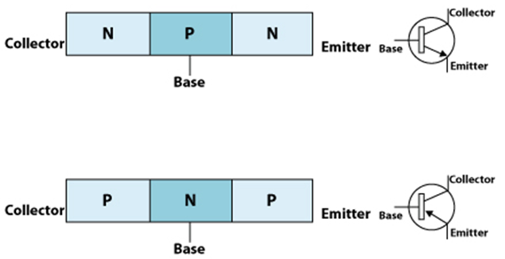
T6B04
Which of the following components can consist of three regions of semiconductor material?
A. Alternator
B. Transistor
C. Triode
D. Pentagrid converter

Slide 41
T6B05
What type of transistor has a gate, drain, and source?
A. Varistor
B. Field-effect
C. Tesla-effect
D. Bipolar junction

Slide 42
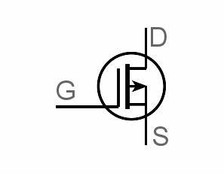
T6B05
What type of transistor has a gate, drain, and source?
A. Varistor
B. Field-effect
C. Tesla-effect
D. Bipolar junction

Slide 43
T6B06
How is the cathode lead of a semiconductor diode often marked on the package?
A. With the word "cathode"
B. With a stripe
C. With the letter C
D. With the letter K

Slide 44
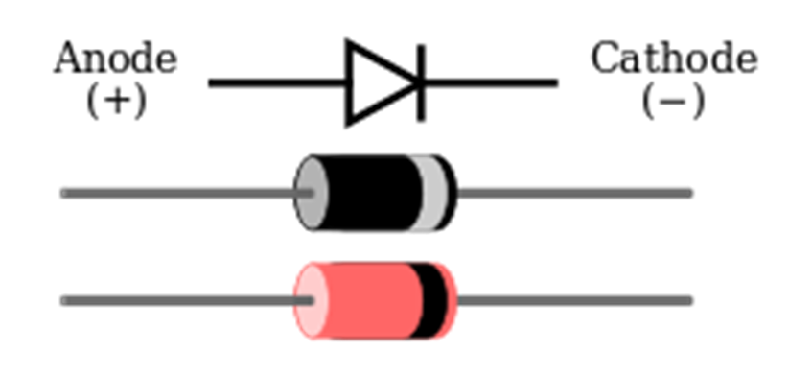
T6B06
How is the cathode lead of a semiconductor diode often marked on the package?
A. With the word "cathode"
B. With a stripe
C. With the letter C
D. With the letter K

Slide 45
T6B07
What causes a light-emitting diode (LED) to emit light?
A. Forward current
B. Reverse current
C. Capacitively-coupled RF signal
D. Inductively-coupled RF signal

Slide 46
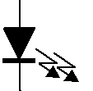
T6B07
What causes a light-emitting diode (LED) to emit light?
A. Forward current
B. Reverse current
C. Capacitively-coupled RF signal
D. Inductively-coupled RF signal
Forward typically means Pass Current
Reverse typically means Block Current

Slide 47
T6B08
What does the abbreviation FET stand for?
A. Frequency Emission Transmitter
B. Fast Electron Transistor
C. Free Electron Transmitter
D. Field Effect Transistor

Slide 48
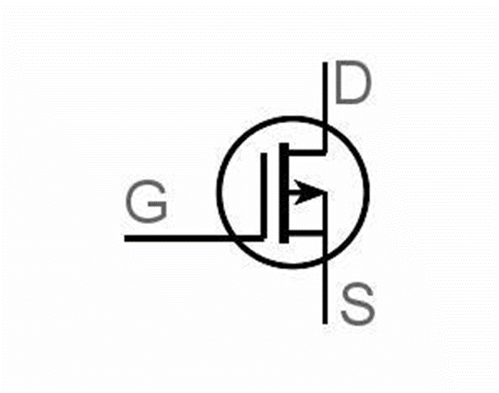
T6B08
What does the abbreviation FET stand for?
A. Frequency Emission Transmitter
B. Fast Electron Transistor
C. Free Electron Transmitter
D. Field Effect Transistor

Slide 49
T6B09
What are the names for the electrodes of a diode?
A. Plus and minus
B. Source and drain
C. Anode and cathode
D. Gate and base

Slide 50
T6B09
What are the names for the electrodes of a diode?
A. Plus and minus
B. Source and drain
C. Anode and cathode
D. Gate and base
Anode Cathode

Slide 51
T6B10
Which of the following can provide power gain?
A. Transformer
B. Transistor
C. Reactor
D. Resistor

Slide 52
T6B10
Which of the following can provide power gain?
A. Transformer
B. Transistor
C. Reactor
D. Resistor
Transistors are voltage controlled variable resistors typically wired as an Amplifier

Slide 53
T6B11
What is the term that describes a device's ability to amplify a signal?
A. Gain
B. Forward resistance
C. Forward voltage drop
D. On resistance

Slide 54
T6B11
What is the term that describes a device's ability to amplify a signal?
A. Gain
B. Forward resistance
C. Forward voltage drop
D. On resistance

Slide 55
T6B12
What are the names of the electrodes of a bipolar junction transistor?
A. Signal, bias, power
B. Emitter, base, collector
C. Input, output, supply
D. Pole one, pole two, output

Slide 56
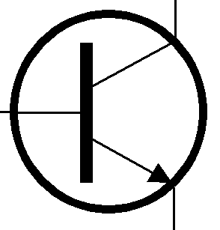
T6B12
What are the names of the electrodes of a bipolar junction transistor?
A. Signal, bias, power
B. Emitter, base, collector
C. Input, output, supply
D. Pole one, pole two, output
Collector
Base
Emitter

Slide 57
T6C - Circuit diagrams: use of schematics, basic structure; Schematic symbols of basic components
#21 of 35

Slide 58
T6C01
What is the name of an electrical wiring diagram that uses standard component symbols?
A. Bill of materials
B. Connector pinout
C. Schematic
D. Flow chart

Slide 59
T6C01
What is the name of an electrical wiring diagram that uses standard component symbols?
A. Bill of materials
B. Connector pinout
C. Schematic
D. Flow chart

Slide 60
T6C02
What is component 1 in figure T-1?
A. Resistor
B. Transistor
C. Battery
D. Connector
Figure T1

Slide 61
T6C02
What is component 1 in figure T-1?
A. Resistor
B. Transistor
C. Battery
D. Connector
Figure T1

Slide 62
T6C03
What is component 2 in figure T-1?
A. Resistor
B. Transistor
C. Indicator lamp
D. Connector
Figure T1

Slide 63
T6C03
What is component 2 in figure T-1?
A. Resistor
B. Transistor
C. Indicator lamp
D. Connector
Figure T1

Slide 64
T6C04
What is component 3 in figure T-1?
A. Resistor
B. Transistor
C. Lamp
D. Ground symbol
Figure T1

Slide 65
T6C04
What is component 3 in figure T-1?
A. Resistor
B. Transistor
C. Lamp
D. Ground symbol
Figure T1

Slide 66
T6C05
What is component 4 in figure T-1?
A. Resistor
B. Transistor
C. Ground symbol
D. Battery
Figure T1

Slide 67
T6C05
What is component 4 in figure T-1?
A. Resistor
B. Transistor
C. Ground symbol
D. Battery
Figure T1

Slide 68
T6C06
What is component 6 in figure T-2?
A. Resistor
B. Capacitor
C. Regulator IC
D. Transistor
Figure T2

Slide 69
T6C06
What is component 6 in figure T-2?
A. Resistor
B. Capacitor
C. Regulator IC
D. Transistor
Figure T2

Slide 70
T6C07
What is component 8 in figure T-2?
A. Resistor
B. Inductor
C. Regulator IC
D. Light emitting diode
Figure T2

Slide 71
T6C07
What is component 8 in figure T-2?
A. Resistor
B. Inductor
C. Regulator IC
D. Light emitting diode
Figure T2

Slide 72
T6C08
What is component 9 in figure T-2?
A. Variable capacitor
B. Variable inductor
C. Variable resistor
D. Variable transformer
Figure T2

Slide 73
T6C08
What is component 9 in figure T-2?
A. Variable capacitor
B. Variable inductor
C. Variable resistor
D. Variable transformer
Figure T2

Slide 74
T6C09
What is component 4 in figure T-2?
A. Variable inductor
B. Double-pole switch
C. Potentiometer
D. Transformer
Figure T2

Slide 75
T6C09
What is component 4 in figure T-2?
A. Variable inductor
B. Double-pole switch
C. Potentiometer
D. Transformer
Figure T2

Slide 76
T6C10
What is component 3 in figure T-3?
A. Connector
B. Meter
C. Variable capacitor
D. Variable inductor
Figure T3

Slide 77
T6C10
What is component 3 in figure T-3?
A. Connector
B. Meter
C. Variable capacitor
D. Variable inductor
Figure T3

Slide 78
T6C11
What is component 4 in figure T-3?
A. Antenna
B. Transmitter
C. Dummy load
D. Ground
Figure T3

Slide 79
T6C11
What is component 4 in figure T-3?
A. Antenna
B. Transmitter
C. Dummy load
D. Ground
Figure T3

Slide 80
T6C12
Which of the following is accurately represented in electrical schematics?
A. Wire lengths
B. Physical appearance of components
C. Component connections
D. All these choices are correct

Slide 81
T6C12
Which of the following is accurately represented in electrical schematics?
A. Wire lengths
B. Physical appearance of components
C. Component connections
D. All these choices are correct

Slide 82
T6D - Component functions: rectifiers, relays, voltage regulators, meters, indicators, integrated circuits, transformers; Resonant circuit; Shielding
#22 of 35

Slide 83
T6D01
Which of the following devices or circuits changes an alternating current into a varying direct current signal?
A. Transformer
B. Rectifier
C. Amplifier
D. Reflector

Slide 84
T6D01
Which of the following devices or circuits changes an alternating current into a varying direct current signal?
A. Transformer
B. Rectifier
C. Amplifier
D. Reflector
A standard diode is also called a Rectifier.

Slide 85
T6D02
Which of the following devices or circuits changes an alternating current into a varying direct current signal?
A. Transformer
B. Rectifier
C. Amplifier
D. Reflector

Slide 86
T6D02
Which of the following devices or circuits changes an alternating current into a varying direct current signal?
A. Transformer
B. Rectifier (is the true correct answer)
C. Amplifier
D. Reflector
This is a wrong answer but if not updated by your test date you must answer Transformer to score a correct answer.

Slide 87
T6D03
Which of the following is a reason to use shielded wire?
A. To decrease the resistance of DC power connections
B. To increase the current carrying capability of the wire
C. To prevent coupling of unwanted signals to or from the wire
D. To couple the wire to other signals

Slide 88
T6D03
Which of the following is a reason to use shielded wire?
A. To decrease the resistance of DC power connections
B. To increase the current carrying capability of the wire
C. To prevent coupling of unwanted signals to or from the wire
D. To couple the wire to other signals

Slide 89
T6D04
Which of the following displays an electrical quantity as a numeric value?
A. Potentiometer
B. Transistor
C. Meter
D. Relay

Slide 90
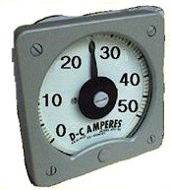
T6D04
Which of the following displays an electrical quantity as a numeric value?
A. Potentiometer
B. Transistor
C. Meter
D. Relay

Slide 91
T6D05
What type of circuit controls the amount of voltage from a power supply?
A. Regulator
B. Oscillator
C. Filter
D. Phase inverter

Slide 92
T6D05
What type of circuit controls the amount of voltage from a power supply?
A. Regulator
B. Oscillator
C. Filter
D. Phase inverter

Slide 93
T6D06
What component changes 120 V AC power to a lower AC voltage for other uses?
A. Variable capacitor
B. Transformer
C. Transistor
D. Diode

Slide 94
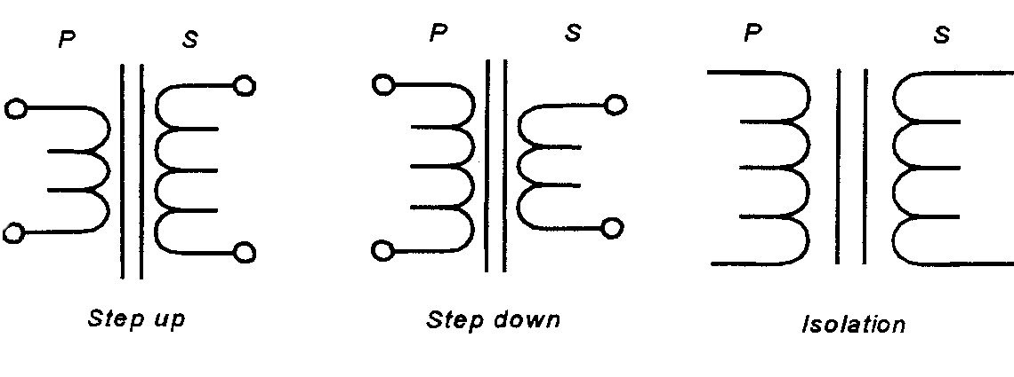
T6D06
What component changes 120 V AC power to a lower AC voltage for other uses?
A. Variable capacitor
B. Transformer
C. Transistor
D. Diode

Slide 95
T6D07
Which of the following is commonly used as a visual indicator?
A. LED
B. FET
C. Zener diode
D. Bipolar transistor

Slide 96
T6D07
Which of the following is commonly used as a visual indicator?
A. LED
B. FET
C. Zener diode
D. Bipolar transistor

Slide 97
T6D08
Which of the following is combined with an inductor to make a resonant circuit?
A. Resistor
B. Zener diode
C. Potentiometer
D. Capacitor

Slide 98
T6D08
Which of the following is combined with an inductor to make a resonant circuit?
A. Resistor
B. Zener diode
C. Potentiometer
D. Capacitor

Slide 99
T6D09
What is the name of a device that combines several semiconductors and other components into one package?
A. Transducer
B. Multi-pole relay
C. Integrated circuit
D. Transformer

Slide 100
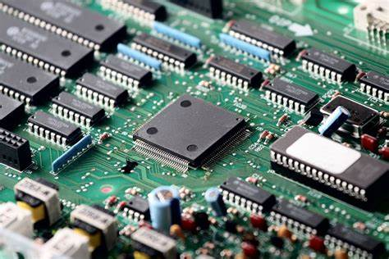
T6D09
What is the name of a device that combines several semiconductors and other components into one package?
A. Transducer
B. Multi-pole relay
C. Integrated circuit
D. Transformer

Slide 101
T6D10
What is the function of component 2 in figure T-1?
A. Give off light when current flows through it
B. Supply electrical energy
C. Control the flow of current
D. Convert electrical energy into radio waves
Figure T1

Slide 102
T6D10
What is the function of component 2 in figure T-1?
A. Give off light when current flows through it
B. Supply electrical energy
C. Control the flow of current
D. Convert electrical energy into radio waves
Figure T1

Slide 103
T6D11
Which of the following is a resonant or tuned circuit?
A. An inductor and a capacitor in series or parallel
B. A linear voltage regulator
C. A resistor circuit used for reducing standing wave ratio
D. A circuit designed to provide high-fidelity audio

Slide 104
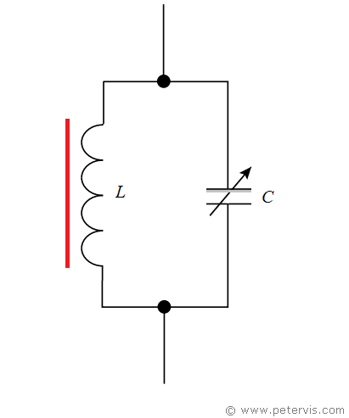
T6D11
Which of the following is a resonant or tuned circuit?
A. An inductor and a capacitor in series or parallel
B. A linear voltage regulator
C. A resistor circuit used for reducing standing wave ratio
D. A circuit designed to provide high-fidelity audio

Slide 105
End of Sub-element 6
(62% Complete)
Proceed to Sub-element 7 when ready

